Slide 1
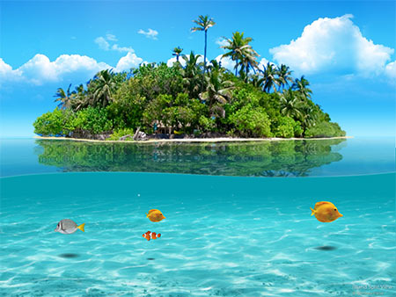
Island life...

Slide 2
What is an island?
It is a piece of land that is surrounded by water . It is smaller that a continent and larger than a rock. There are islands all over the world-the pacific ocean has 30,000 islands. Islands are very special places and each one has its own plants and animals. Madagascar, off Africa , is an island where there are tropical forests,deserts,mountains,rivers and lakes. It has more wildlife than a continent.

Slide 3
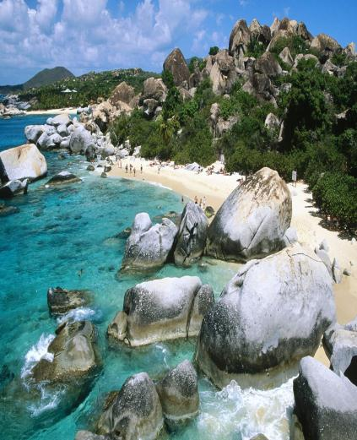
The new words...
Surrounded: محاط
Continent: قارة
Rock: صخرة
Pacific ocean: محيط الاطلسي
Tropical: إستوائي
Lakes: بحيرات
Wildlife: الحياة البرية

Slide 4
What is an island? 2
Islands develop life slowly. Seeds are brought by wind, sea or birds. Animals that can fly come next. Land animals are the last to arrive. Then, over millions of years, the plants and animals which live on islands change. For example, in Hawaii, butterflies became heavier. This topped the wind carrying them into the sea.

Slide 5
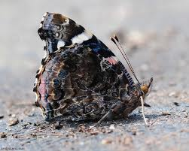
The new words...
Develop: تطوير
Seeds:البذور
Wind:الرياح
Butterflies:الفراشات
Heavier:أثقل
Carrying:حمل
Sea:البحر

Slide 6
What is an island? 3
In 1963, a volcano erupted off the coast of Iceland, near the arctic circle, and over the next few days Surtsey island was born. Scientists had the chance to study this new island where there were no animals or plants. Forty-five years later, 69 kinds of plants are growing there and there are many insects and birds.

Slide 7
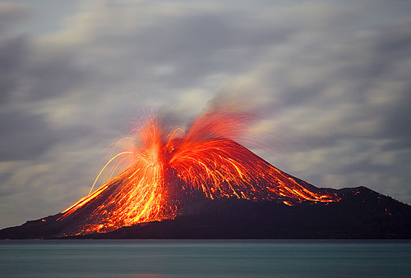
The new words...
Volcano: بركان
Erupted: إندلع
Coast: الساحل
Arctic circle: منطقة القطب الشمالي
Scientists: العلماء
Chance: فرصة
Insects: الحشرات

Slide 8
What is an island? 4
In the past, the people who lived the islands changed them. On one island, local people cut down the trees to build boats. They used the boats to catch fish. When there was no more wood, the people died. Visitors who sailed to islands also changed them. For example, ships introduced goats which destroyed native plants.

Slide 9
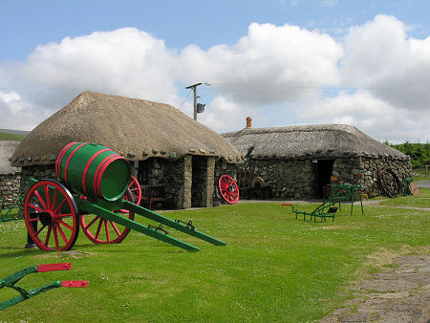
The new words...
Local: المحلية
Cut down: يقطع
Catch fish: صيد الأسماك
Wood: الخشب
Visitors: الزوار
Sailed: أبحر
Ships: السفن
Introduced: قدم
Destroyed: دمر
Native: الأصلية

Slide 10
What is an island? 5
These days many of the animals that are found on islands are in danger. Of all the birds which became extinct in the last 200 years, most lived on islands . The orang-utan lives in the rainforests or Borneo and Sumatra in the far east, where people are cutting down the forests and destroying their home.

Slide 11
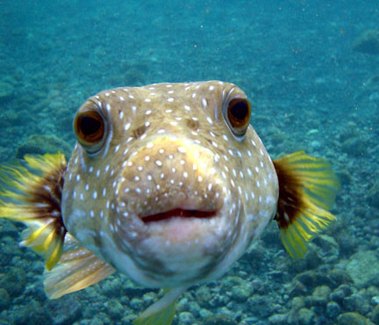
The new words...
Found: وجدت
Danger: خطر
Extinct: منقرض
Orang-utan: انسان الغابة
Rainforests: الغابات المطيرة
Destroying: تدمير

Slide 12
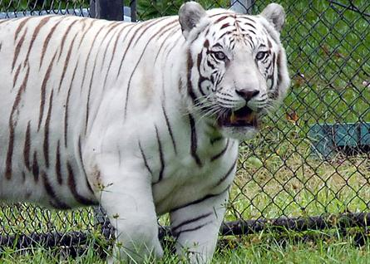
.

Slide 13
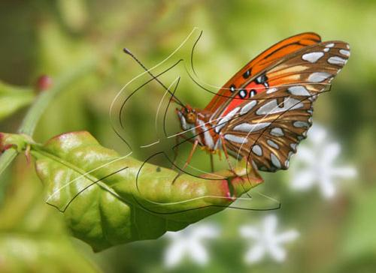

Slide 14
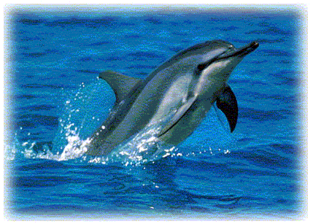

Slide 15
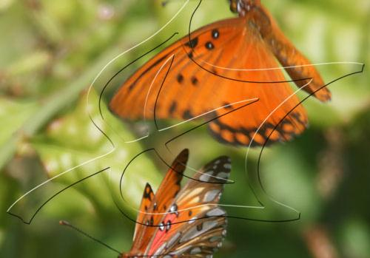

Slide 16
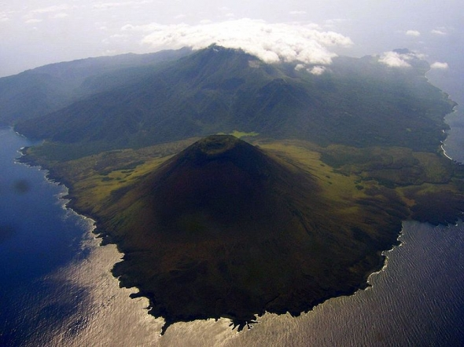

Slide 17
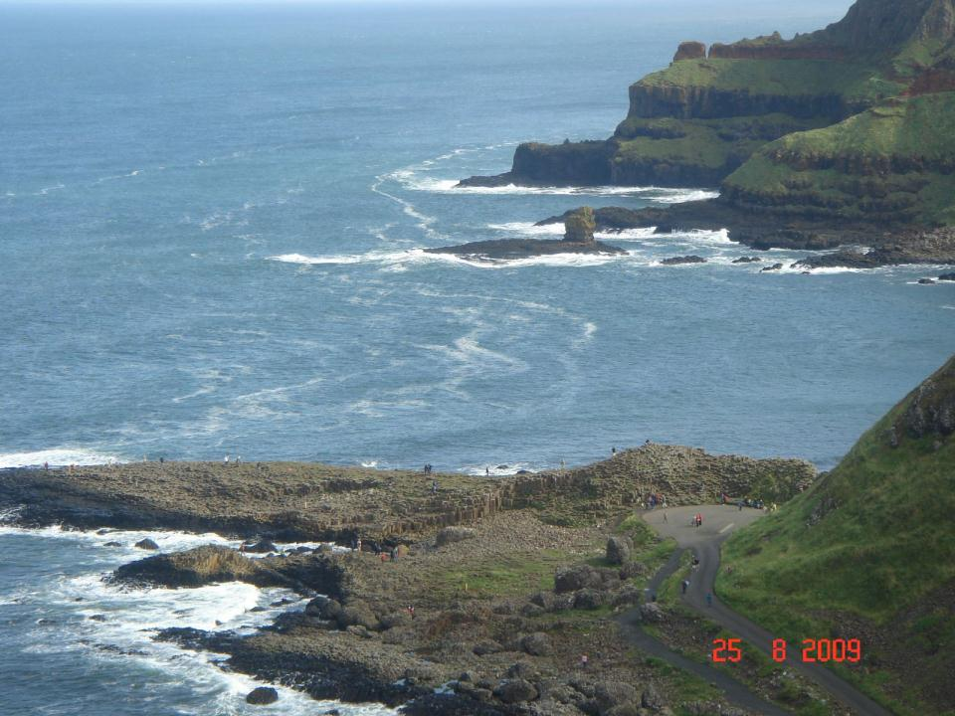

Slide 18
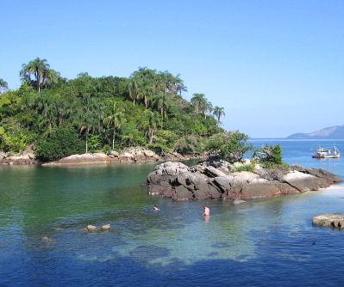

Slide 19
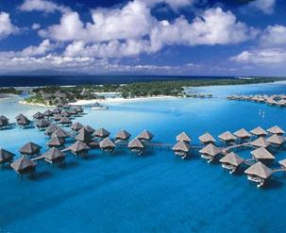
The End
Powerpoint by Masa Na3ourh

